Slide 2
"Data are not just numbers,
they are numbers with a context."
- George Cobb and David Moore (1997)

Slide 3
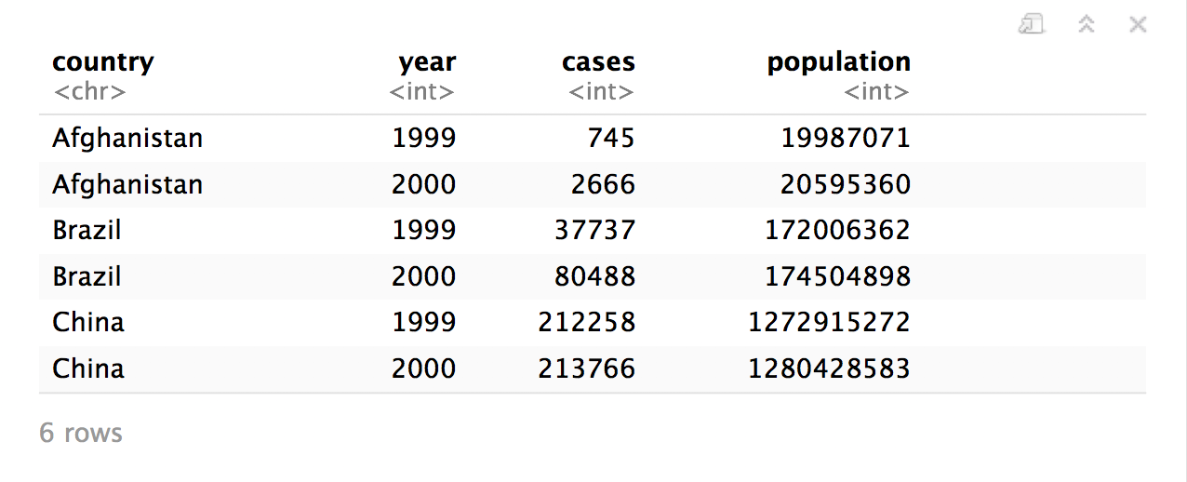
Quiz
What are the variables in this data set?
table1

Slide 4
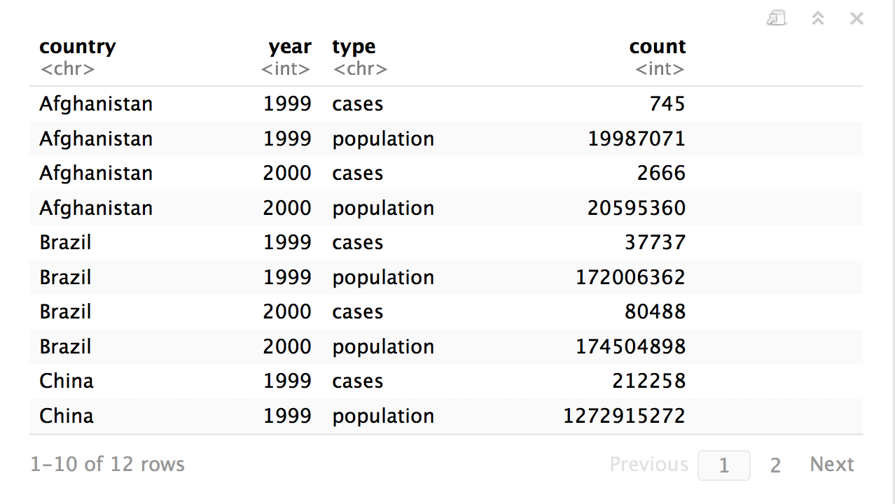
Quiz
What are the variables in this data set?
table2

Slide 5
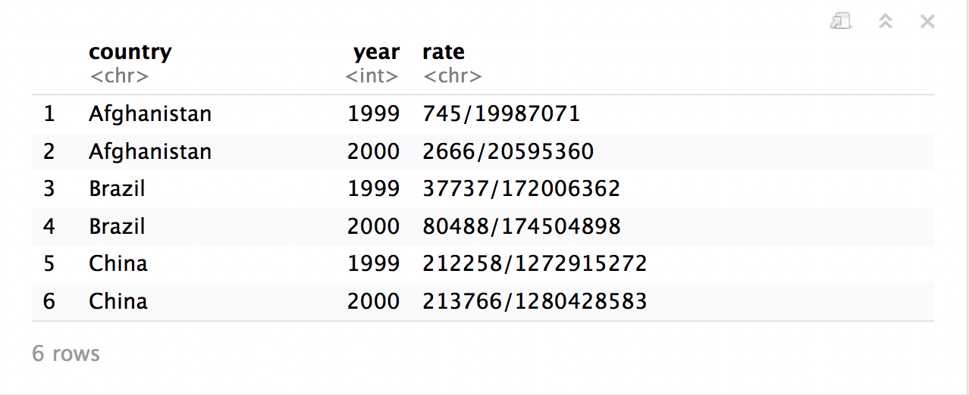

table3
CC BY-SA RStudio

Slide 6
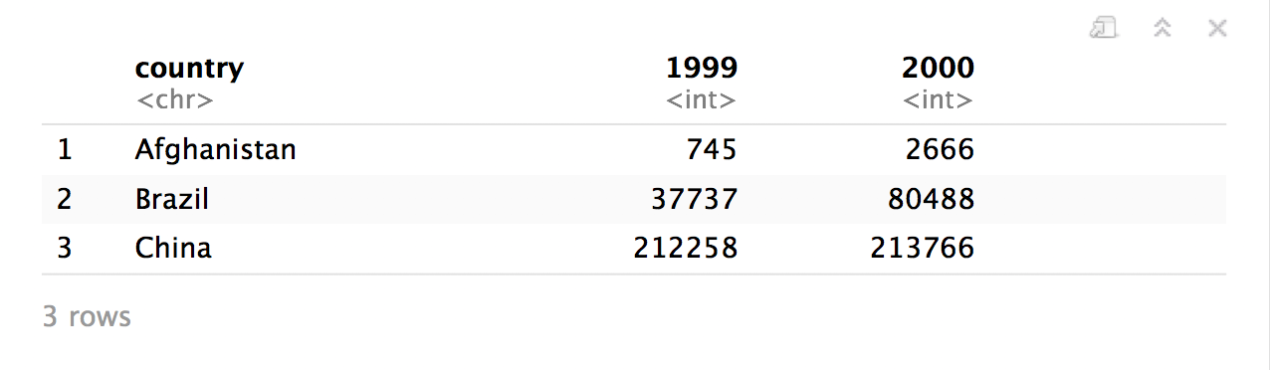
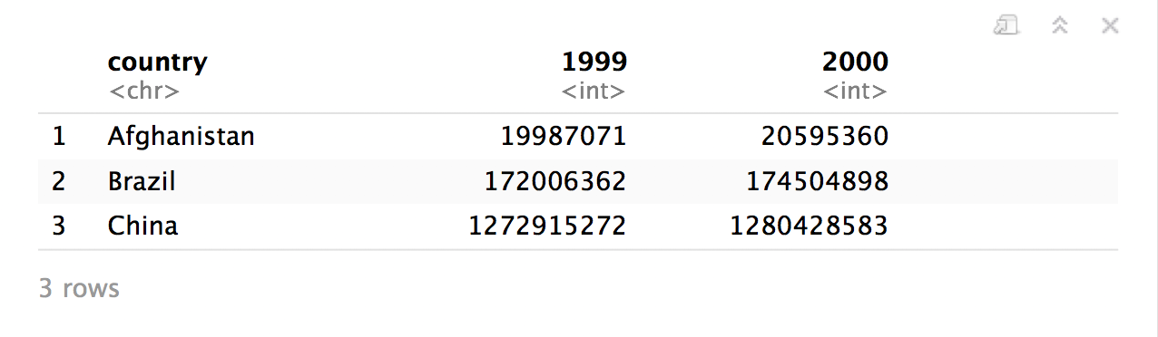
table4a
table4b
CC BY-SA RStudio

Slide 7
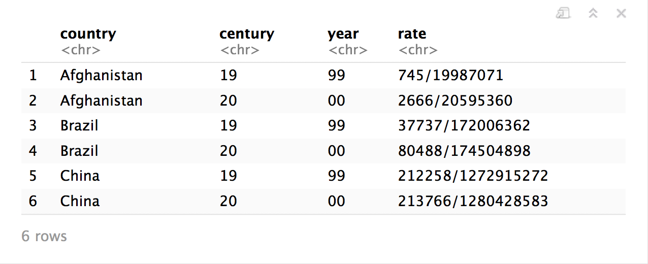
table5
CC BY-SA RStudio

Slide 8
"Data comes in many formats, but R prefers just one: tidy data. "
- Garrett Grolemund

Slide 9
Tidy data
country | year | cases | pop
Afghanistan | 1999 | 745 | 19987071
Afghanistan | 2000 | 2666 | 20595360
Brazil | 1999 | 37737 | 172006362
Brazil | 2000 | 80488 | 174504898
China | 1999 | 212258 | 1272915272
China | 2000 | 213766 | 1280428583
A data set is tidy if:
Each variable is in its own column
Each case is in its own row
Each value is in its own cell

Slide 10
table1$country
table1$year
table1$cases
table1$population

Slide 11


table2$country
table2$year
table2$count[c(1,3,5,7,9,11)]
table2$count[c(2,4,6,8,10,12)]

Slide 12
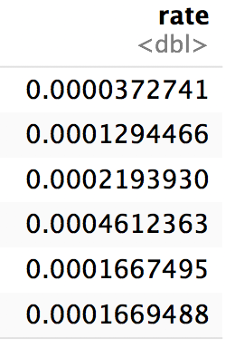
table1$cases / table1$population -> table1$rate

Slide 13
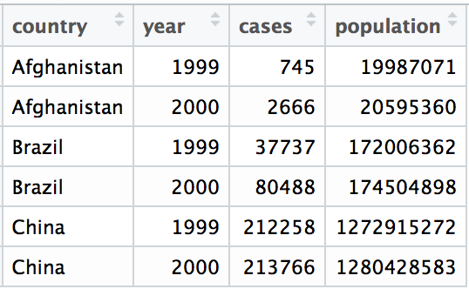
Tidy data
A data set is tidy iff:
Each variable is in its own column
Each case is in its own row
Each value is in its own cell

Slide 14
Import data into software
Collect
Data
Tidy data into useable form
Design Experiment
Explore or Test
Form Hypothesis
Transform the data. Do feature engineering.
Deploy app or publish paper
Write code to apply a modeling algorithm.
Build app or write paper
Visualize the data and/or results
Communicate Results

Slide 15
Tidy data into useable form
Import data into software
Munge data
Collect
Data
Explore or Test
Design Experiment
Transform the data. Do feature engineering.
Form Hypothesis
Munge data
Deploy app or publish paper
Write code to apply a modeling algorithm.
Build app or write paper
Munge data
Communicate Results
Visualize the data and/or results
Munge data

Slide 16
Tidy data
Tidy functions all expect and return the same data structure, known as tidy data:
A data frame that contains
variables in the columns and
cases in the rows.

Slide 17
"Tidy data sets are all alike; but every messy data set is messy in its own way."
- Hadley Wickham

Slide 18

tidyr

Slide 19
tidyr
A package that reshapes the layout of tabular data.
CC BY-SA RStudio

Slide 20
pivot_longer( )

Slide 21
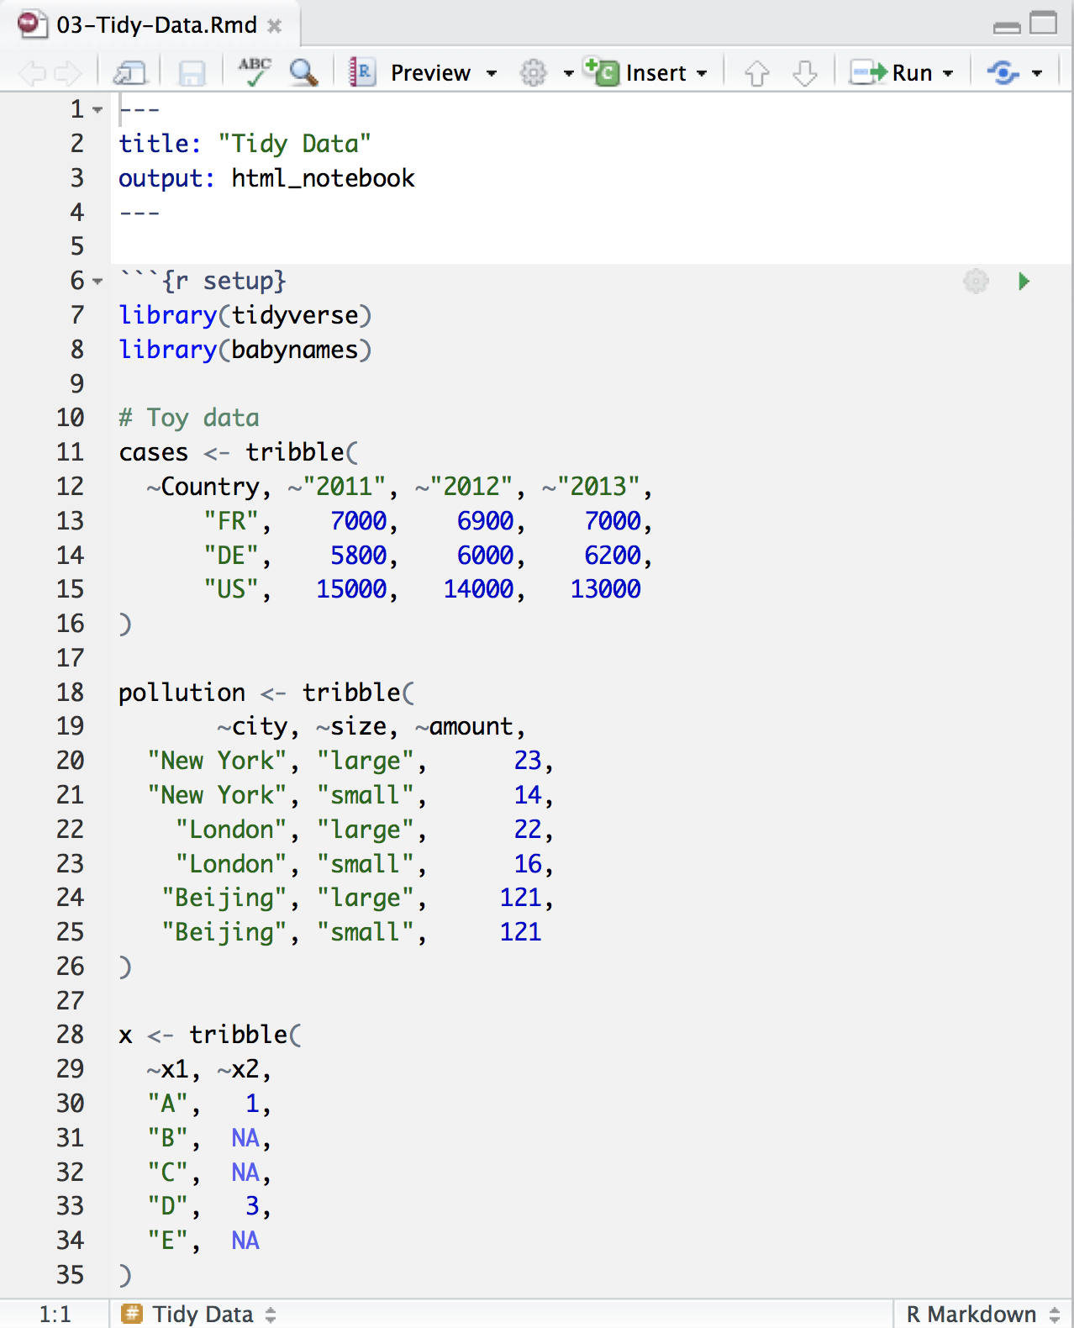
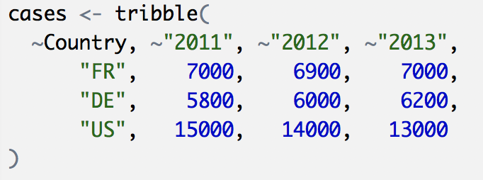
Toy data
CC BY-SA RStudio

Slide 22
Quiz
What are the variables in cases?
Country | 2011 | 2012 | 2013
FR | 7000 | 6900 | 7000
DE | 5800 | 6000 | 6200
US | 15000 | 14000 | 13000

Slide 23
Quiz
What are the variables in cases?
Country | 2011 | 2012 | 2013
FR | 7000 | 6900 | 7000
DE | 5800 | 6000 | 6200
US | 15000 | 14000 | 13000
Country
Year
Count

Slide 24
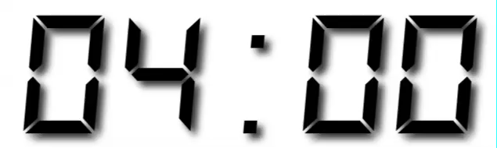
Your Turn 1
On a sheet of paper, draw how the cases data set would look if it had the same values grouped into three columns: country, year, n
Country | 2011 | 2012 | 2013
FR | 7000 | 6900 | 7000
DE | 5800 | 6000 | 6200
US | 15000 | 14000 | 13000

Slide 25
Country | 2011 | 2012 | 2013
FR | 7000 | 6900 | 7000
DE | 5800 | 6000 | 6200
US | 15000 | 14000 | 13000
CC BY-SA RStudio

Slide 26
Country | 2011 | 2012 | 2013
FR | 7000 | 6900 | 7000
DE | 5800 | 6000 | 6200
US | 15000 | 14000 | 13000
Country | Year | n
FR | 2011 | 7000
DE | 2011 | 5800
US | 2011 | 15000
FR | 2012 | 6900
DE | 2012 | 6000
US | 2012 | 14000
FR | 2013 | 7000
DE | 2013 | 6200
US | 2013 | 13000
CC BY-SA RStudio

Slide 27
Country | 2011 | 2012 | 2013
FR | 7000 | 6900 | 7000
DE | 5800 | 6000 | 6200
US | 15000 | 14000 | 13000
Country | Year | n
FR | 2011 | 7000
DE | 2011 | 5800
US | 2011 | 15000
FR | 2012 | 6900
DE | 2012 | 6000
US | 2012 | 14000
FR | 2013 | 7000
DE | 2013 | 6200
US | 2013 | 13000
CC BY-SA RStudio

Slide 28
Country | 2011 | 2012 | 2013
FR | 7000 | 6900 | 7000
DE | 5800 | 6000 | 6200
US | 15000 | 14000 | 13000
Country | Year | n
FR | 2011 | 7000
DE | 2011 | 5800
US | 2011 | 15000
FR | 2012 | 6900
DE | 2012 | 6000
US | 2012 | 14000
FR | 2013 | 7000
DE | 2013 | 6200
US | 2013 | 13000
CC BY-SA RStudio

Slide 29
Country | 2011 | 2012 | 2013
FR | 7000 | 6900 | 7000
DE | 5800 | 6000 | 6200
US | 15000 | 14000 | 13000
Country | Year | n
FR | 2011 | 7000
DE | 2011 | 5800
US | 2011 | 15000
FR | 2012 | 6900
DE | 2012 | 6000
US | 2012 | 14000
FR | 2013 | 7000
DE | 2013 | 6200
US | 2013 | 13000
CC BY-SA RStudio

Slide 30
Country | 2011 | 2012 | 2013
FR | 7000 | 6900 | 7000
DE | 5800 | 6000 | 6200
US | 15000 | 14000 | 13000
Country | Year | n
FR | 2011 | 7000
DE | 2011 | 5800
US | 2011 | 15000
FR | 2012 | 6900
DE | 2012 | 6000
US | 2012 | 14000
FR | 2013 | 7000
DE | 2013 | 6200
US | 2013 | 13000
CC BY-SA RStudio

Slide 31
Country | 2011 | 2012 | 2013
FR | 7000 | 6900 | 7000
DE | 5800 | 6000 | 6200
US | 15000 | 14000 | 13000
Country | Year | n
FR | 2011 | 7000
DE | 2011 | 5800
US | 2011 | 15000
FR | 2012 | 6900
DE | 2012 | 6000
US | 2012 | 14000
FR | 2013 | 7000
DE | 2013 | 6200
US | 2013 | 13000
CC BY-SA RStudio

Slide 32
Country | 2011 | 2012 | 2013
FR | 7000 | 6900 | 7000
DE | 5800 | 6000 | 6200
US | 15000 | 14000 | 13000
Country | Year | n
FR | 2011 | 7000
DE | 2011 | 5800
US | 2011 | 15000
FR | 2012 | 6900
DE | 2012 | 6000
US | 2012 | 14000
FR | 2013 | 7000
DE | 2013 | 6200
US | 2013 | 13000
CC BY-SA RStudio

Slide 33
Country | 2011 | 2012 | 2013
FR | 7000 | 6900 | 7000
DE | 5800 | 6000 | 6200
US | 15000 | 14000 | 13000
Country | Year | n
FR | 2011 | 7000
DE | 2011 | 5800
US | 2011 | 15000
FR | 2012 | 6900
DE | 2012 | 6000
US | 2012 | 14000
FR | 2013 | 7000
DE | 2013 | 6200
US | 2013 | 13000
CC BY-SA RStudio

Slide 34
Country | 2011 | 2012 | 2013
FR | 7000 | 6900 | 7000
DE | 5800 | 6000 | 6200
US | 15000 | 14000 | 13000
Country | Year | n
FR | 2011 | 7000
DE | 2011 | 5800
US | 2011 | 15000
FR | 2012 | 6900
DE | 2012 | 6000
US | 2012 | 14000
FR | 2013 | 7000
DE | 2013 | 6200
US | 2013 | 13000
CC BY-SA RStudio

Slide 35
Country | 2011 | 2012 | 2013
FR | 7000 | 6900 | 7000
DE | 5800 | 6000 | 6200
US | 15000 | 14000 | 13000
Country | Year | n
FR | 2011 | 7000
DE | 2011 | 5800
US | 2011 | 15000
FR | 2012 | 6900
DE | 2012 | 6000
US | 2012 | 14000
FR | 2013 | 7000
DE | 2013 | 6200
US | 2013 | 13000
CC BY-SA RStudio

Slide 36
Country | 2011 | 2012 | 2013
FR | 7000 | 6900 | 7000
DE | 5800 | 6000 | 6200
US | 15000 | 14000 | 13000
Country | Year | n
FR | 2011 | 7000
DE | 2011 | 5800
US | 2011 | 15000
FR | 2012 | 6900
DE | 2012 | 6000
US | 2012 | 14000
FR | 2013 | 7000
DE | 2013 | 6200
US | 2013 | 13000
CC BY-SA RStudio

Slide 37
Country | 2011 | 2012 | 2013
FR | 7000 | 6900 | 7000
DE | 5800 | 6000 | 6200
US | 15000 | 14000 | 13000
Country | Year | n
FR | 2011 | 7000
DE | 2011 | 5800
US | 2011 | 15000
FR | 2012 | 6900
DE | 2012 | 6000
US | 2012 | 14000
FR | 2013 | 7000
DE | 2013 | 6200
US | 2013 | 13000
pivot_longer
CC BY-SA RStudio

Slide 38
1
2
Country | 2011 | 2012 | 2013
FR | 7000 | 6900 | 7000
DE | 5800 | 6000 | 6200
US | 15000 | 14000 | 13000
Country | Year | n
FR | 2011 | 7000
DE | 2011 | 5800
US | 2011 | 15000
FR | 2012 | 6900
DE | 2012 | 6000
US | 2012 | 14000
FR | 2013 | 7000
DE | 2013 | 6200
US | 2013 | 13000
CC BY-SA RStudio

Slide 39
names_to (former column names)
Country | 2011 | 2012 | 2013
FR | 7000 | 6900 | 7000
DE | 5800 | 6000 | 6200
US | 15000 | 14000 | 13000
Country | Year | n
FR | 2011 | 7000
DE | 2011 | 5800
US | 2011 | 15000
FR | 2012 | 6900
DE | 2012 | 6000
US | 2012 | 14000
FR | 2013 | 7000
DE | 2013 | 6200
US | 2013 | 13000
CC BY-SA RStudio

Slide 40
values_to (former cells)
Country | 2011 | 2012 | 2013
FR | 7000 | 6900 | 7000
DE | 5800 | 6000 | 6200
US | 15000 | 14000 | 13000
Country | Year | n
FR | 2011 | 7000
DE | 2011 | 5800
US | 2011 | 15000
FR | 2012 | 6900
DE | 2012 | 6000
US | 2012 | 14000
FR | 2013 | 7000
DE | 2013 | 6200
US | 2013 | 13000
CC BY-SA RStudio

Slide 41
pivot_longer()
cases %>%
pivot_longer(cols, names_to= , values_to = )
Which columns to reshape?
New variable created from column names
New variable created from cell values

Slide 42
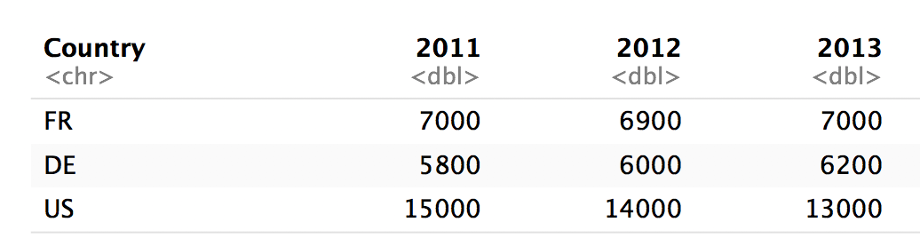
pivot_longer()
cases %>%
pivot_longer(cols = 2:4, names_to = "year", values_to = "count")
Column numbers
2
3
4

Slide 43
pivot_longer()
cases %>%
pivot_longer(cols=c(“2011”,”2012”,”2013”),
names_to = "year", values_to = "count")
Column names
2011
2012
2013

Slide 44
pivot_longer()
cases %>%
pivot_longer(-Country, names_to = "year", values_to = "count")
Everything except
Not Country
Not Country
Not Country

Slide 45
pivot_longer()
pivot_longer(cols = 2:4,
names_to = "year", values_to = "count")
pivot_longer(cols=c("2011", "2012", "2013"),
names_to = "year", values_to = "count")
pivot_longer(cols = starts_with("201"),
names_to = "year", values_to = "count")
pivot_longer(-Country,
names_to = "year", values_to = "count")

Slide 46
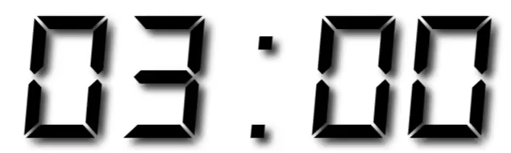
Your Turn 2
Use pivot_longer() to reorganize table4a into three columns: country, year, and cases.

Slide 47
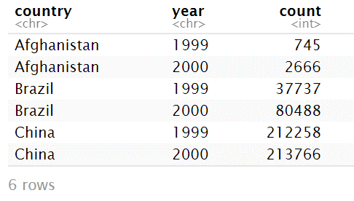
table4a %>%
pivot_longer(-country,
names_to = "year", values_to = "count")

Slide 48
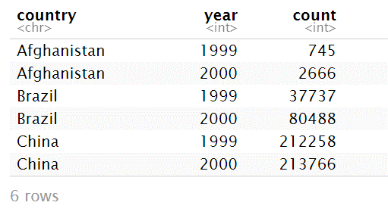
table4a %>%
pivot_longer(-country,
names_to = "year", names_ptypes = list(year = integer())
values_to = "count")

Slide 49
pivot_wider( )

Slide 50
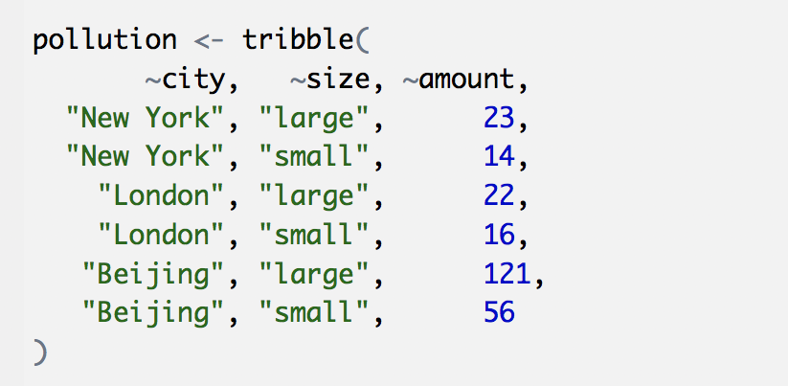
Toy data
CC BY-SA RStudio

Slide 51
Quiz
What are the variables in pollution?
city | particle size | amount (µg/m³)
New York | large | 23
New York | small | 14
London | large | 22
London | small | 16
Beijing | large | 121
Beijing | small | 56

Slide 52

Quiz
What are the variables in pollution?
city | particle size | amount (µg/m³)
New York | large | 23
New York | small | 14
London | large | 22
London | small | 16
Beijing | large | 121
Beijing | small | 56
City
Amount of large particulate
Amount of small particulate

Slide 53
Your Turn 3
On a sheet of paper, draw how this data set would look if it had the same values grouped into three columns: city, large, small
city | size | amount
New York | large | 23
New York | small | 14
London | large | 22
London | small | 16
Beijing | large | 121
Beijing | small | 56

Slide 54
city | size | amount
New York | large | 23
New York | small | 14
London | large | 22
London | small | 16
Beijing | large | 121
Beijing | small | 56
CC BY-SA RStudio

Slide 55
city | size | amount
New York | large | 23
New York | small | 14
London | large | 22
London | small | 16
Beijing | large | 121
Beijing | small | 56
city | large | small
New York | 23 | 14
London | 22 | 16
Beijing | 121 | 56
CC BY-SA RStudio

Slide 56
city | size | amount
New York | large | 23
New York | small | 14
London | large | 22
London | small | 16
Beijing | large | 121
Beijing | small | 56
city | large | small
New York | 23 | 14
London | 22 | 16
Beijing | 121 | 56
CC BY-SA RStudio

Slide 57
city | size | amount
New York | large | 23
New York | small | 14
London | large | 22
London | small | 16
Beijing | large | 121
Beijing | small | 56
city | large | small
New York | 23 | 14
London | 22 | 16
Beijing | 121 | 56
CC BY-SA RStudio

Slide 58
city | size | amount
New York | large | 23
New York | small | 14
London | large | 22
London | small | 16
Beijing | large | 121
Beijing | small | 56
city | large | small
New York | 23 | 14
London | 22 | 16
Beijing | 121 | 56
CC BY-SA RStudio

Slide 59
city | size | amount
New York | large | 23
New York | small | 14
London | large | 22
London | small | 16
Beijing | large | 121
Beijing | small | 56
city | large | small
New York | 23 | 14
London | 22 | 16
Beijing | 121 | 56
CC BY-SA RStudio

Slide 60
city | size | amount
New York | large | 23
New York | small | 14
London | large | 22
London | small | 16
Beijing | large | 121
Beijing | small | 56
city | large | small
New York | 23 | 14
London | 22 | 16
Beijing | 121 | 56
CC BY-SA RStudio

Slide 61
city | size | amount
New York | large | 23
New York | small | 14
London | large | 22
London | small | 16
Beijing | large | 121
Beijing | small | 56
city | large | small
New York | 23 | 14
London | 22 | 16
Beijing | 121 | 56
CC BY-SA RStudio

Slide 62
city | size | amount
New York | large | 23
New York | small | 14
London | large | 22
London | small | 16
Beijing | large | 121
Beijing | small | 56
city | large | small
New York | 23 | 14
London | 22 | 16
Beijing | 121 | 56
CC BY-SA RStudio

Slide 63
city | size | amount
New York | large | 23
New York | small | 14
London | large | 22
London | small | 16
Beijing | large | 121
Beijing | small | 56
city | large | small
New York | 23 | 14
London | 22 | 16
Beijing | 121 | 56
pivot_wider()
CC BY-SA RStudio

Slide 64
1
2
city | size | amount
New York | large | 23
New York | small | 14
London | large | 22
London | small | 16
Beijing | large | 121
Beijing | small | 56
city | large | small
New York | 23 | 14
London | 22 | 16
Beijing | 121 | 56
CC BY-SA RStudio

Slide 65
names_from
(new column names)
city | size | amount
New York | large | 23
New York | small | 14
London | large | 22
London | small | 16
Beijing | large | 121
Beijing | small | 56
city | large | small
New York | 23 | 14
London | 22 | 16
Beijing | 121 | 56
CC BY-SA RStudio

Slide 66
values_from
(new cells)
city | size | amount
New York | large | 23
New York | small | 14
London | large | 22
London | small | 16
Beijing | large | 121
Beijing | small | 56
city | large | small
New York | 23 | 14
London | 22 | 16
Beijing | 121 | 56
CC BY-SA RStudio

Slide 67
pivot_wider( )
pollution %>%
pivot_wider( names_from = , values_from = )
data frame to reshape
New columns from names in this variable
Values for these columns from this variable

Slide 68
pollution %>% pivot_wider(names_from = size,
values_from = amount)
city size amount
1 New York large 23
2 New York small 14
3 London large 22
4 London small 16
5 Beijing large 121
6 Beijing small 56
city large small
1 Beijing 121 56
2 London 22 16
3 New York 23 14
CC BY-SA RStudio

Slide 69
Your Turn 4
Use pivot_wider() to reorganize table2 into four columns: country, year, cases, and population.

Slide 70
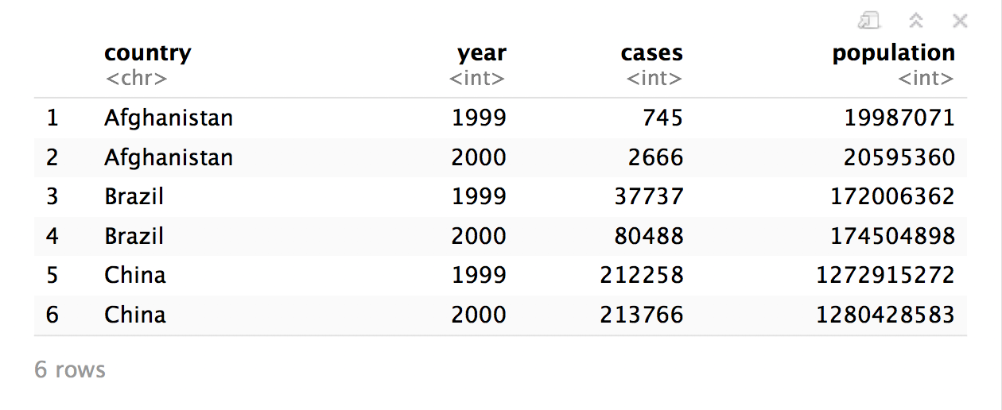
table2 %>%
pivot_wider(names_from = type,
values_from = count)

Slide 71
who
(Untidy Data)

Slide 72
who
Tuberculosis (TB) cases broken down by year, country, age, gender, and diagnosis method from the 2014 World Health Organization Global Tuberculosis Report
View(who)

Slide 73
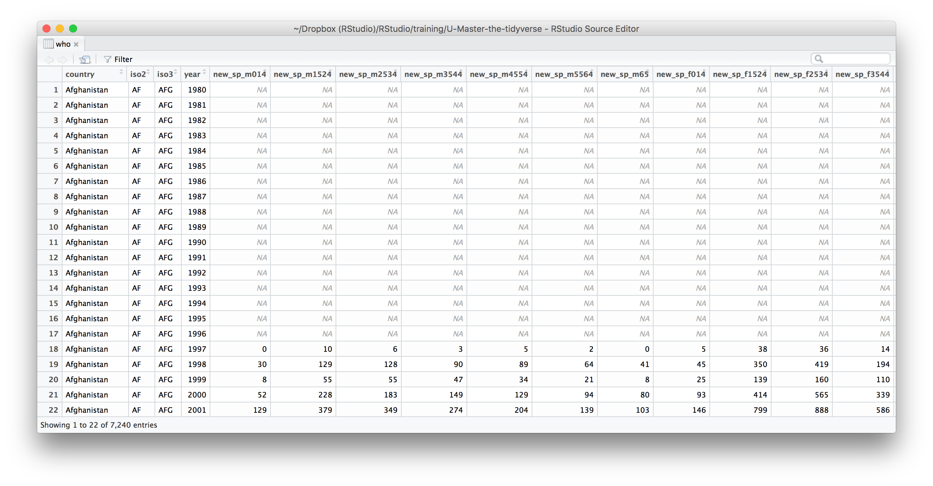
What variables does this data set contain?

Slide 74
who variables
country, iso2, iso3 - country identifiers
year - year
other columns names - encode type of TB case, sex, and age

Slide 75
who codes
Type of TB case
rel - relapse
ep - extra-pulmonary
sn- pulmonary, smear negative
sp -pulmonary, smear positive
Gender
m - male
f - female
Age group
014 - 0 to 14 years old
1524 - 15 to 24 years old
2534 - 25 to 34 years old
3544 - 35 to 44 years old
4554 - 45 to 54 years old
5564 - 55 to 64 years old
65 - 65 and older

Slide 77
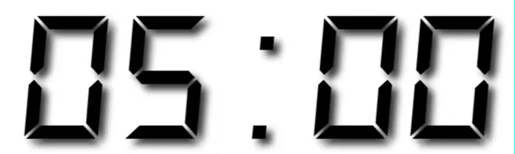
Your Turn 5
Gather the 5th through 60th columns of who into a pair of key:value columns named codes and n.
Then select just the county, year, codes and n variables.

Slide 78
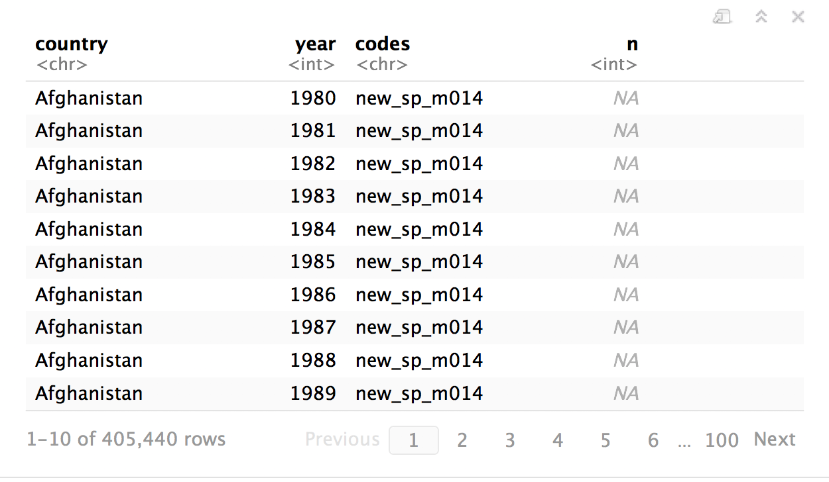
who %>%
pivot_longer(cols = 5:60, names_to="codes", values_to="n") %>%
select(-iso2, -iso3)

Slide 79
separate()

Slide 80
separate()
Splits a column by dividing values at a specific character.
who %>%
pivot_longer(cols = 5:60, names_to="codes", values_to="n") %>%
select(-iso2, -iso3) %>%
separate(codes, into = c("new", "type", "sexage"), sep = "_")
a column to split
names of new columns to make
string to split on
(Defaults to any non_alpha-numeric character)

Slide 81
separate(storms, date, c("year","month","day"), sep = "-")
storm wind pressure date
1 Alberto 110 1007 2000-08-03
2 Alex 45 1009 1998-07-27
3 Allison 65 1005 1995-06-03
4 Ana 40 1013 1997-06-30
5 Arlene 50 1010 1999-06-11
6 Arthur 45 1010 1996-06-17
storm wind pressure year month day
1 Alberto 110 1007 2000 08 03
2 Alex 45 1009 1998 07 27
3 Allison 65 1005 1995 06 03
4 Ana 40 1013 1997 06 30
5 Arlene 50 1010 1999 06 11
6 Arthur 45 1010 1996 06 17

Slide 82
separate(storms, date, c("year","month","day"), sep = "-")
storm wind pressure date
1 Alberto 110 1007 2000-08-03
2 Alex 45 1009 1998-07-27
3 Allison 65 1005 1995-06-03
4 Ana 40 1013 1997-06-30
5 Arlene 50 1010 1999-06-11
6 Arthur 45 1010 1996-06-17
storm wind pressure year month day
1 Alberto 110 1007 "2000" "08" "03"
2 Alex 45 1009 "1998" "07" "27"
3 Allison 65 1005 "1995" "06" "03"
4 Ana 40 1013 "1997" "06" "30"
5 Arlene 50 1010 "1999" "06" "11"
6 Arthur 45 1010 "1996" "06" "17"

Slide 83
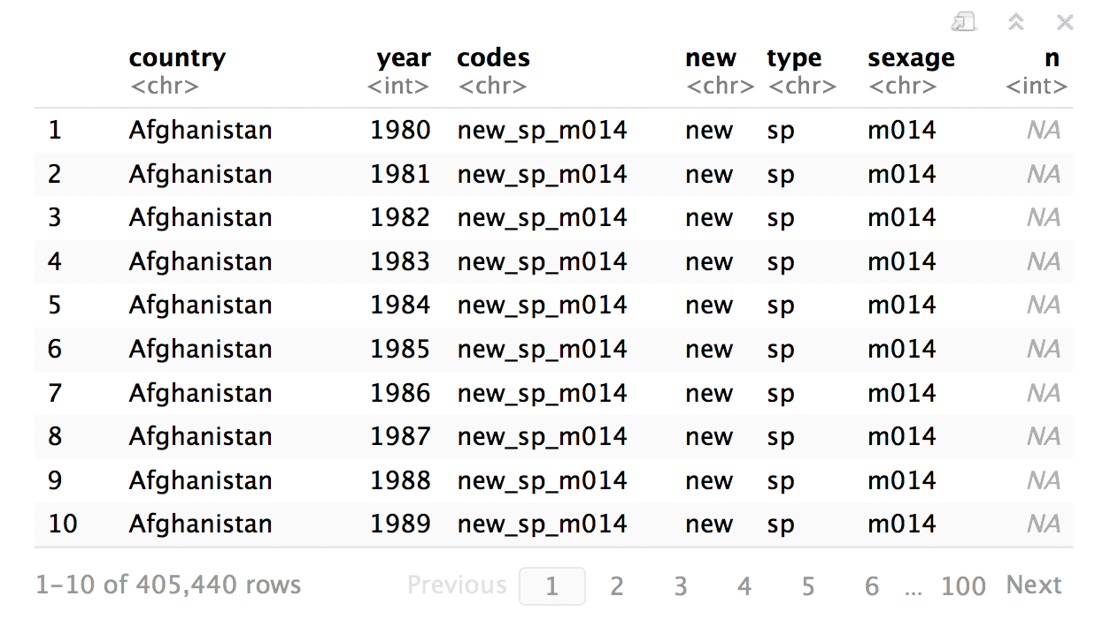
who %>%
pivot_longer(cols = 5:60, names_to="codes", values_to="n") %>%
select(-iso2, -iso3) %>%
separate(
)

Slide 84
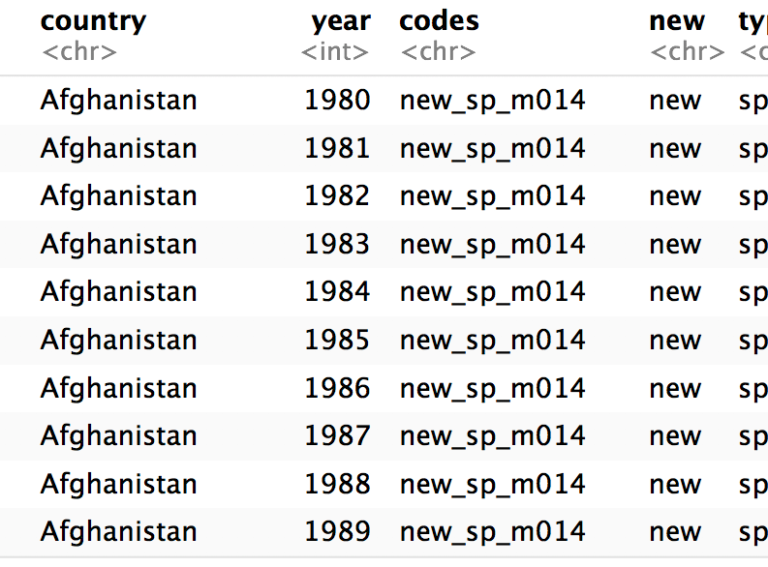
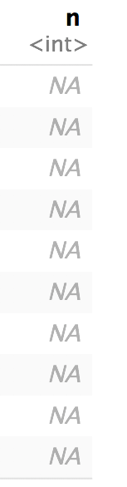

who %>%
pivot_longer(cols = 5:60, names_to="codes", values_to="n") %>%
select(-iso2, -iso3) %>%
separate(codes
)

Slide 85
who %>%
pivot_longer(cols = 5:60, names_to="codes", values_to="n") %>%
select(-iso2, -iso3) %>%
separate(codes, into = c("new", "type", "sexage")
)

Slide 86
who %>%
pivot_longer(cols = 5:60, names_to="codes", values_to="n") %>%
select(-iso2, -iso3) %>%
separate(codes, into = c("new", "type", "sexage"), sep = "_")
)

Slide 87
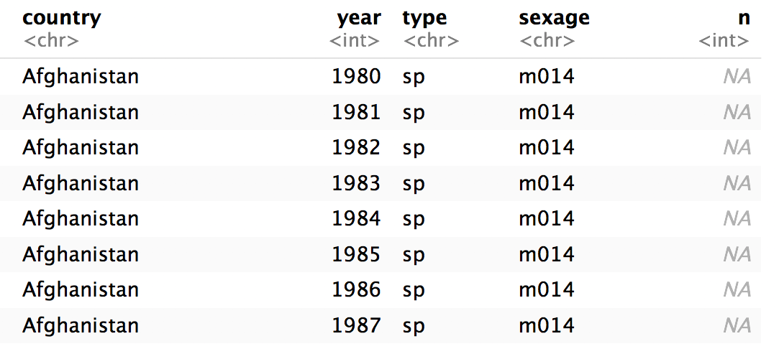
who %>%
pivot_longer(cols = 5:60, names_to="codes", values_to="n") %>%
select(-iso2, -iso3) %>%
separate(codes, c("new", "type", "sexage"), sep = "_") %>%
select(-new)

Slide 88
separate()
Splits a column by dividing values at a specific character.
who %>%
pivot_longer(cols = 5:60, names_to="codes", values_to="n") %>%
select(-iso2, -iso3) %>%
separate(codes, c("new", "type", "sexage"), sep = c(4, 7))
locations to split at
(Split after 4th and 7th characters)

Slide 89
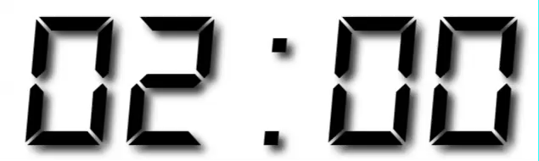
Your Turn 6
Separate the sexage column into sex and age columns.

Slide 90
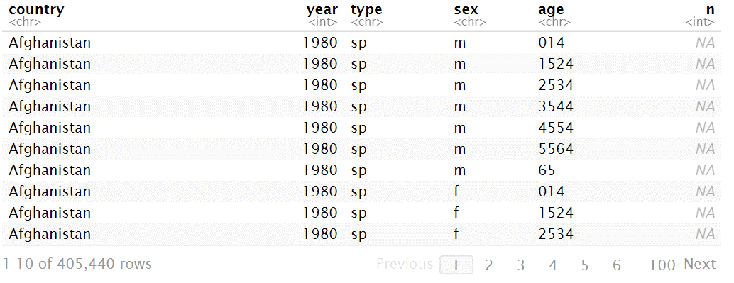
who %>%
pivot_longer(cols = 5:60, names_to="codes", values_to="n") %>%
select(-iso2, -iso3) %>%
separate(codes, c("new", "type", "sexage"), sep = "_") %>%
select(-new) %>%
separate(sexage, into = c("sex", "age"), sep = 1)

Slide 91
unite()

Slide 92
unite()
Unites columns into single column by combining cells.
unite(data, col, …, sep = "")
data frame to reshape
name of new column to make
(in quotes)
two or more columns to combine
separator to place between elements in new column
(Defaults to an underscore)

Slide 93
Missing
Values

Slide 94
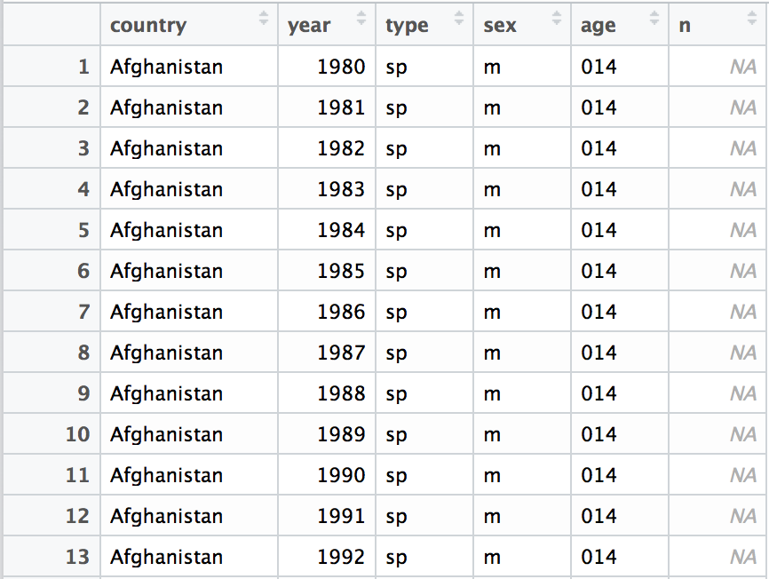
Can we clean up the missing values?

Slide 95
Toy data
x
x <- tribble(
~x1, ~x2,
"A", 1,
"B", NA,
"C", NA,
"D", 3,
"E", NA
)
x1 | x2
A | 1
B | NA
C | NA
D | 3
E | NA

Slide 96
fill()
Fills in NA’s with preceding (or following) values.
fill(x, x2, .direction = "down")
data frame to transform
column(s) with NA’s to replace
"down" fills each NA with the preceding value, "up" with the following value

Slide 97
fill()
Fills in NA’s with preceding (or following) values.
fill(x, x2, .direction = "down")
x
x
x1 | x2
A | 1
B | NA
C | NA
D | 3
E | NA
x1 | x2
A | 1
B | 1
C | 1
D | 3
E | 3

Slide 98
fill()
Fills in NA’s with preceding (or following) values.
fill(x, x2, .direction = "up")
x
x
x1 | x2
A | 1
B | NA
C | NA
D | 3
E | NA
x1 | x2
A | 1
B | 3
C | 3
D | 3
E | NA

Slide 99
replace_na()
Replace NA’s by column.
replace_na(x, replace = list(x2 = 2))
data frame to transform
A named list of column names paired with values to replace NA’s with.

Slide 100
replace_na()
Replace NA’s by column.
replace_na(x, replace = list(x2 = 2))
x
x
x1 | x2
A | 1
B | NA
C | NA
D | 3
E | NA
x1 | x2
A | 1
B | 2
C | 2
D | 3
E | 2

Slide 101
drop_na()
Drops rows that contain NA’s in the specified columns.
drop_na(x, x2)
data frame to transform
column(s) to screen for NA’s

Slide 102
drop_na()
Drops rows that contain NA’s in the specified columns.
drop_na(x, x2)
x
x
x1 | x2
A | 1
B | NA
C | NA
D | 3
E | NA
x1 | x2
A | 1
D | 3

Slide 103
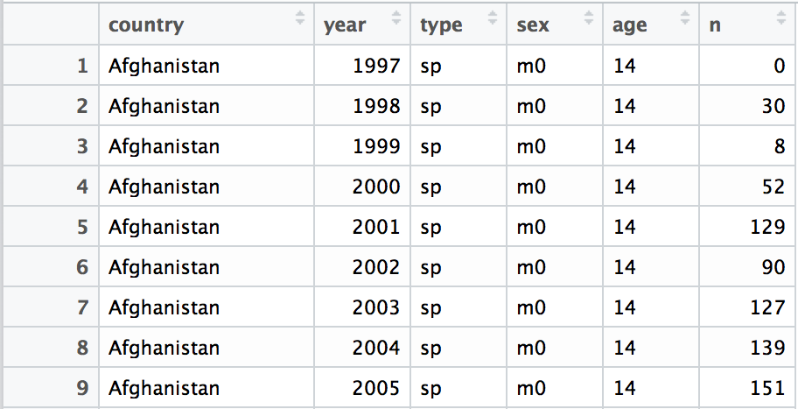
who %>%
pivot_longer(cols = 5:60, names_to="codes", values_to="n") %>%
separate(codes, c("new", "type", "sexage"), sep = "_") %>%
select(-new, -iso2, -iso3) %>%
separate(sexage, c("sex", "age"), sep = 2) %>%
drop_na(n)

Slide 104
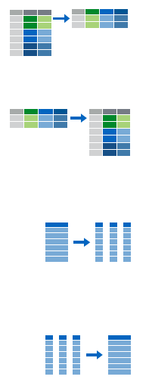
Recap
Move values into column names with spread()
Move column names into values with gather()
Split a column with separate() or separate_rows()
Unite columns with unite()

Slide 106
Reshaping
Final Exam

Slide 107
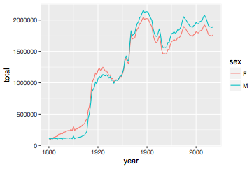
Number of children by year and gender
CC BY-SA RStudio

Slide 108
Can we calculate the ratio of boys to girls?
babynames %>%
group_by(year, sex) %>%
summarise(n = sum(n))
year sex n
<dbl> <chr> <int>
1 1880 F 90993
2 1880 M 110491
3 1881 F 91954
4 1881 M 100745
5 1882 F 107850
6 1882 M 113688
7 1883 F 112321

Slide 109
Can we calculate the ratio of boys to girls?
babynames %>%
group_by(year, sex) %>%
summarise(n = sum(n))
year sex n
<dbl> <chr> <int>
1 1880 F 90993
2 1880 M 110491
3 1881 F 91954
4 1881 M 100745
5 1882 F 107850
6 1882 M 113688
7 1883 F 112321
Now what?

Slide 110
Can we calculate the ratio of boys to girls?
better_layout %>%
mutate(percent_male = M / (M + F) * 100)
year sex n
<dbl> <chr> <int>
1 1880 F 90993
2 1880 M 110491
3 1881 F 91954
4 1881 M 100745
5 1882 F 107850
6 1882 M 113688
7 1883 F 112321
year F M
* <dbl> <int> <int>
1 1880 90993 110491
2 1881 91954 100745
3 1882 107850 113688
4 1883 112321 104629
5 1884 129022 114445
6 1885 133055 107800
7 1886 144535 110784
?

Slide 111
Your Turn 7
Reshape the layout of this data. Calculate the percent of male (or female) children by year. Then plot the percent over time.
babynames %>%
group_by(year, sex) %>%
summarise(n = sum(n))

Slide 112
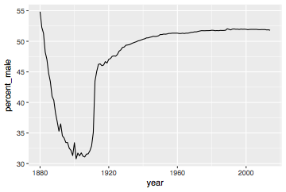
babynames %>%
group_by(year, sex) %>%
summarise(n = sum(n)) %>%
pivot_wider(names_from = sex, values_from = n) %>%
mutate(percent_male = M / (M + F) * 100) %>%
ggplot(aes(year, percent_male)) + geom_line()
CC BY-SA RStudio

Slide 113
Percent of children that are male by year
CC BY-SA RStudio

Slide 114
General advice
Describe what you want to do in an equation. Each variable in the equation should correspond to a variable in your data:
"color by sex"
color = sex
"calculate the proportion of males"
prop male = number of males / number of females + number of males

